Slide 1
Software engineering project Hotel Management System Team: Check-in Crew Team Members: Haleema Tahir Malik 22i-0937 Muhammad Daniyal Aziz 22i-0753 Moaz Farooq 22i-1173

Slide 2
Introduction of System
Purpose:
Streamline hotel operations for guests, staff, and administrators.
Goals:
Automate bookings and complaints handling
Improve user experience
Manage hotel data centrally

Slide 3
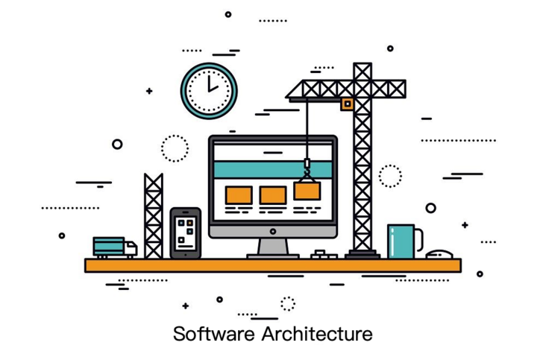
Architecture

Slide 4
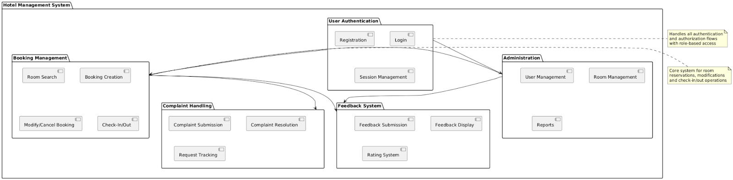
Package Diagram

Slide 5
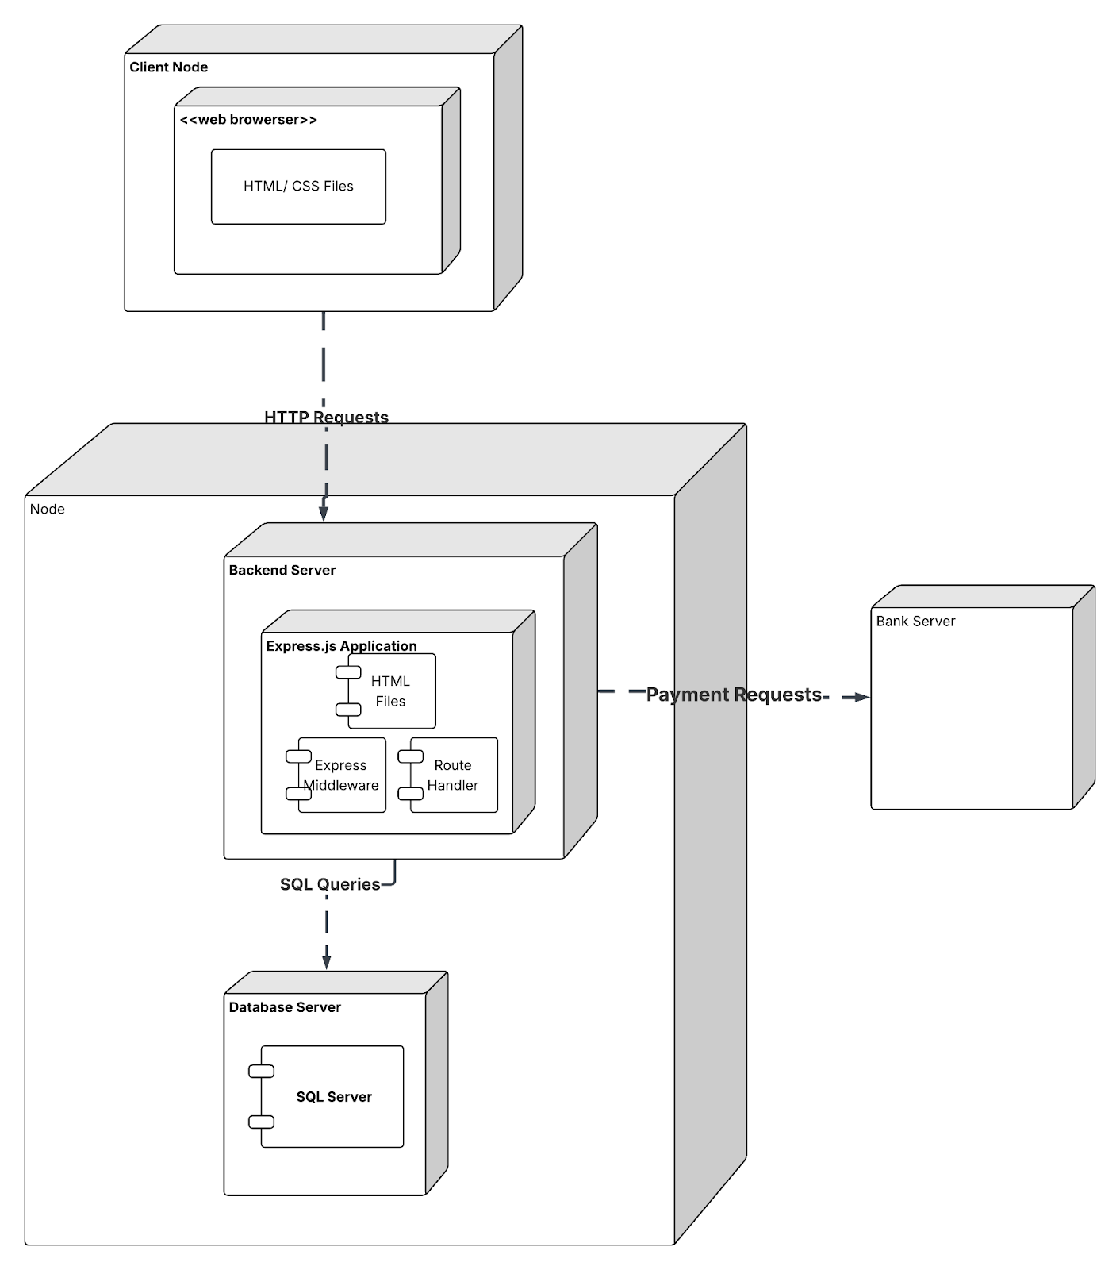
Deployment Diagram
Browser (Frontend)
Express Server (Backend)
MySQL Database (Data Layer)

Slide 6
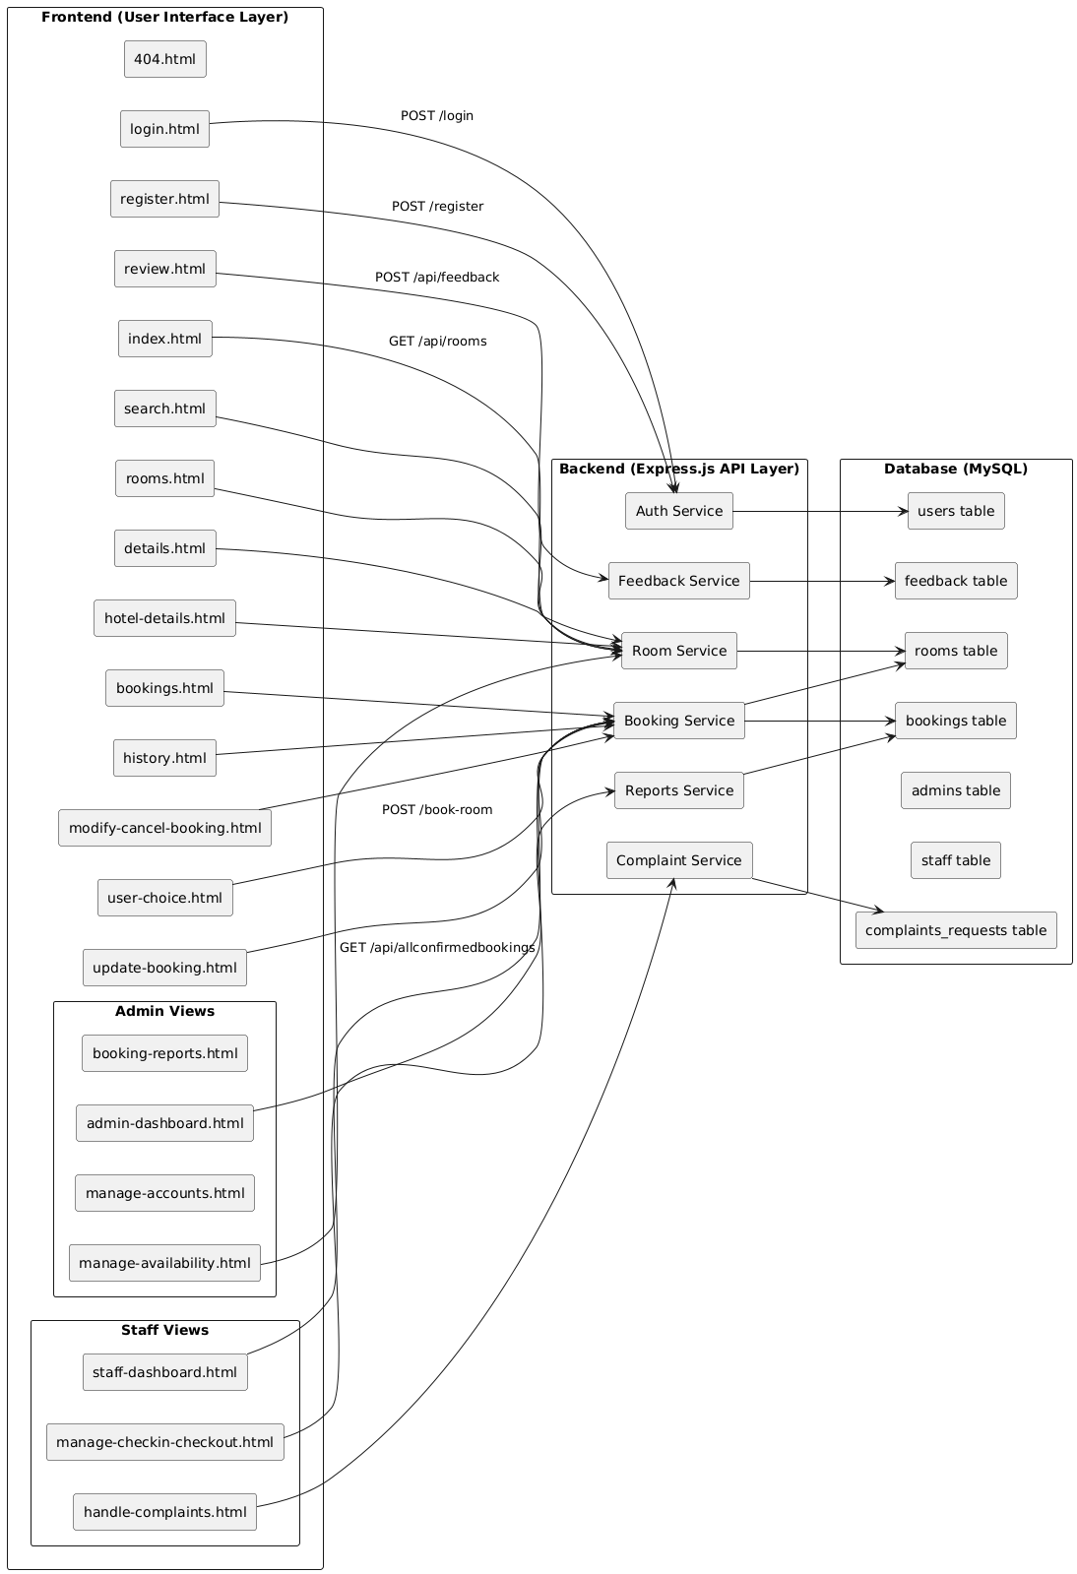
Component Diagram
Components:
Room
Booking
Payment
Feedback modules

Slide 7
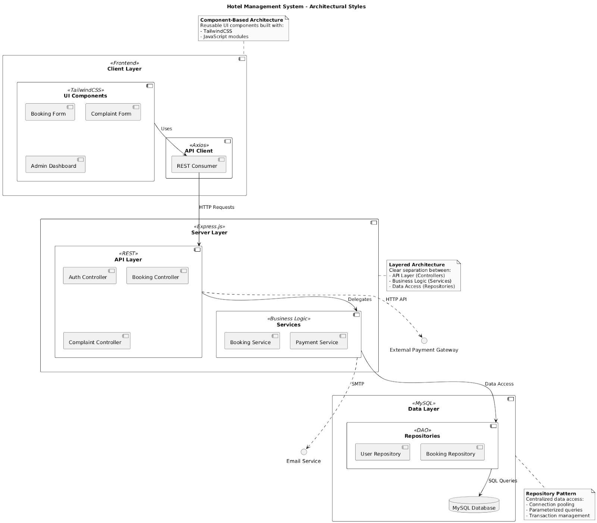
Multi-layered Architecture
Presentation Layer:
Tailwind CSS, HTML, JavaScript
Business Logic Layer:
Express.js Backend
Data Layer:
MySQL Database

Slide 8
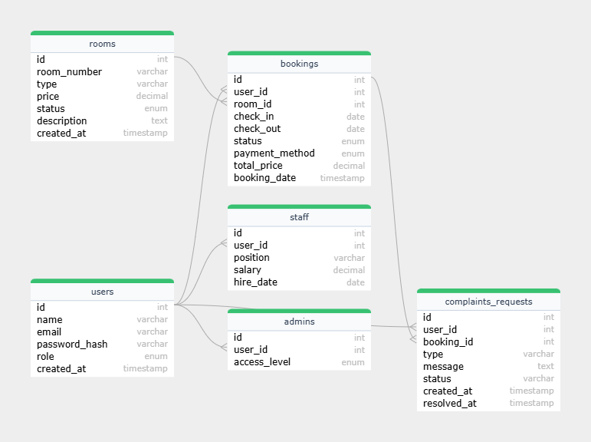
ERD

Slide 9
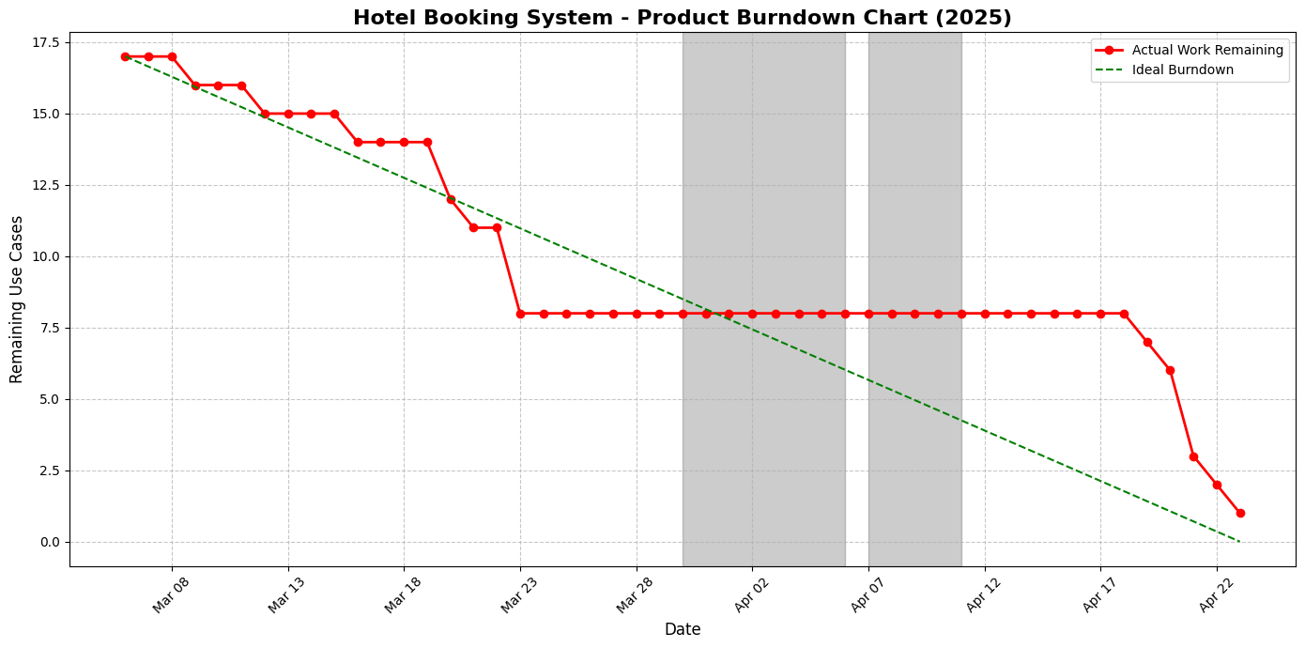
PRODUCT BURNDOWN CHART

Slide 10
Project Planner

Slide 11
Work Breakdown Structure
Phase | Task | Sub-Task/Deliverable
1. Requirements Gathering | - Define system requirements - Gather user stories - Create use case diagrams | Functional and Non-Functional Requirements Use Case Diagram
2. Design | - Design system architecture - Database schema design - UI/UX wireframes | Architecture Diagram Database Tables Initial Page Designs
3. Development (Sprint 1 & 2) | - Frontend development (HTML, CSS, Tailwind) - Backend setup (API, database connection) - User Authentication - Room browsing and booking functionality | Working prototype with Login/Register, Bookings, Search Rooms
4. Sprint 3 and Enhancements | - Staff dashboard - Admin dashboard - Review, Feedback, Complaint handling pages | Fully functional Staff/Admin roles and features
5. Testing | - Unit testing - Integration testing - User acceptance testing (UAT) | Test Cases (Black Box and White Box Testing)
6. Finalization | - Report compilation - Presentation preparation | Final Report (this one) Presentation Slides

Slide 12
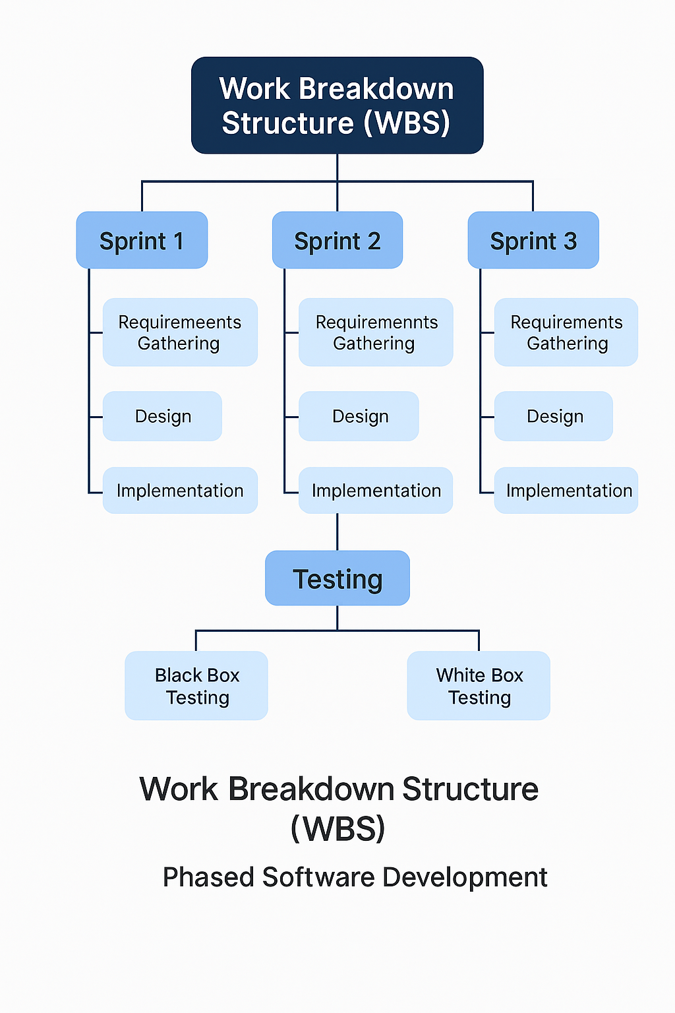

Slide 13
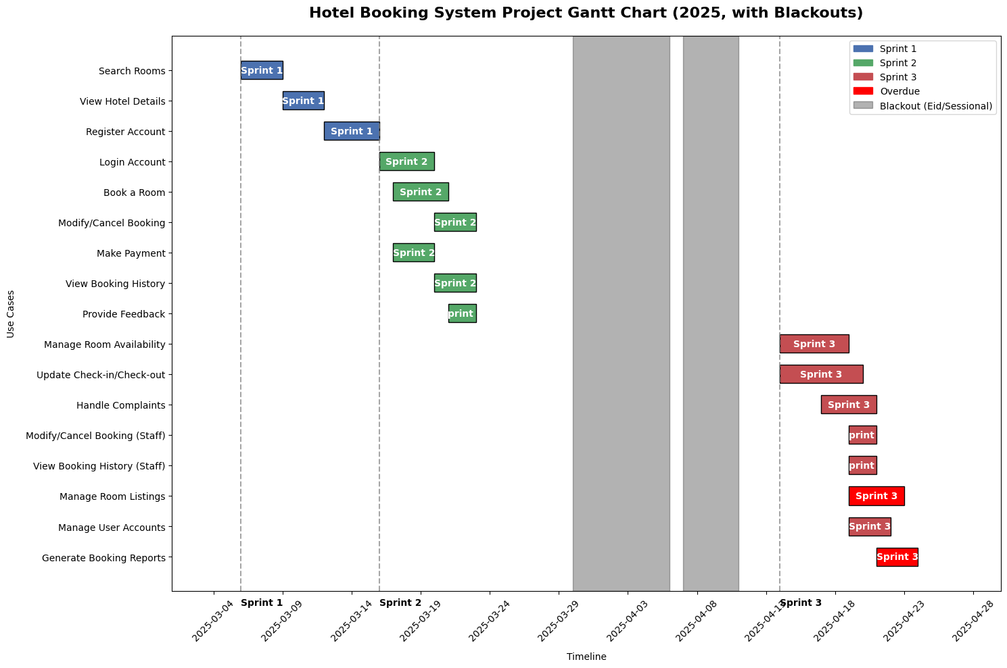
Gantt Chart

Slide 14
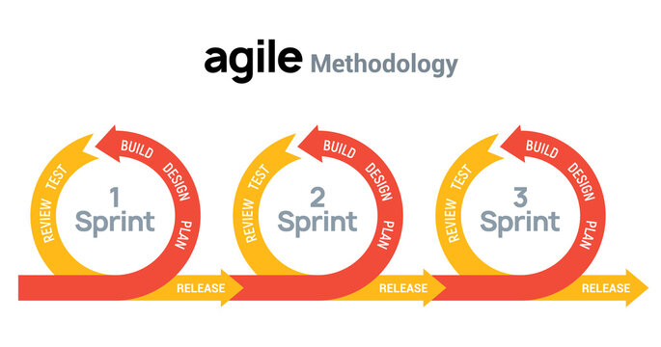
Sprint Planning
Sprint 1:
Guest user and Registered User functionalities
Log-In/Register
Users are able to view and select room for booking
Sprint 2:
Registered Users can make bookings and
modify/cancel them
Registered Users can make payments
Registered Users can give feedbacks
Sprint 3:
Staff/Admin functions and testing
Manage room availability
Update Check-In/ Check-out
Handle Customer Complaints
Manage User and Staff Accounts
Generate Reports

Slide 15
Main User Stories
User Story | Description | Priority | Sprint
Book a Room US7 | As a guest, I want to book a room by selecting dates, entering guest details, and choosing a payment method, so I can secure my stay. | High | Completed (Sprint 2)
Make Payment US9 | As a guest, I want to make a secure payment for my booking using options like credit card or PayPal, so I can complete my reservation. | High | Completed (Sprint 2)
Manage Room Availability US12 | As a staff member, I want to manage room availability (e.g., mark rooms as available or unavailable), so I can ensure accurate booking information. | Medium | Completed (Sprint 3)
Modify/Cancel Booking (Staff) US15 | As a staff member, I want to modify or cancel a guest’s booking on their behalf, so I can assist with changes or cancellations. | Medium | Completed (Sprint 3)
Manage User and Staff Accounts US18 | As an admin, I want to manage user and staff accounts (e.g., create, update, delete accounts), so I can control access to the system. | Low | Completed (Sprint 3)

Slide 16
Screenshots of actual implementation

Slide 17
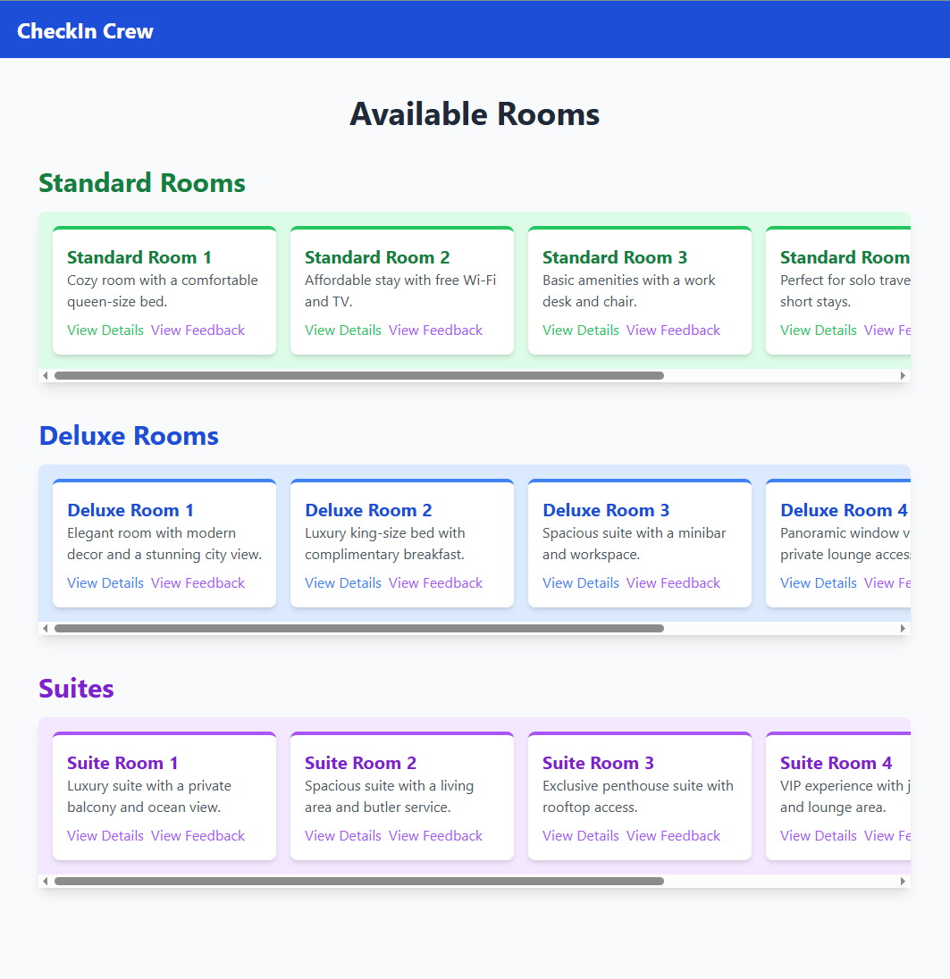

Slide 18
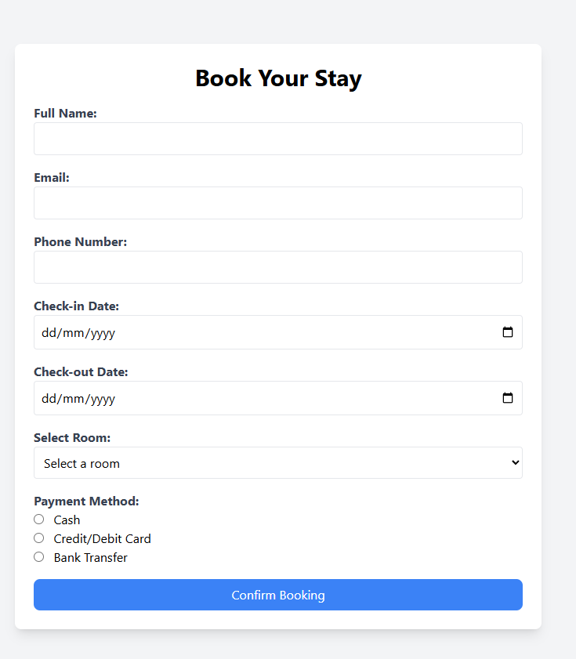
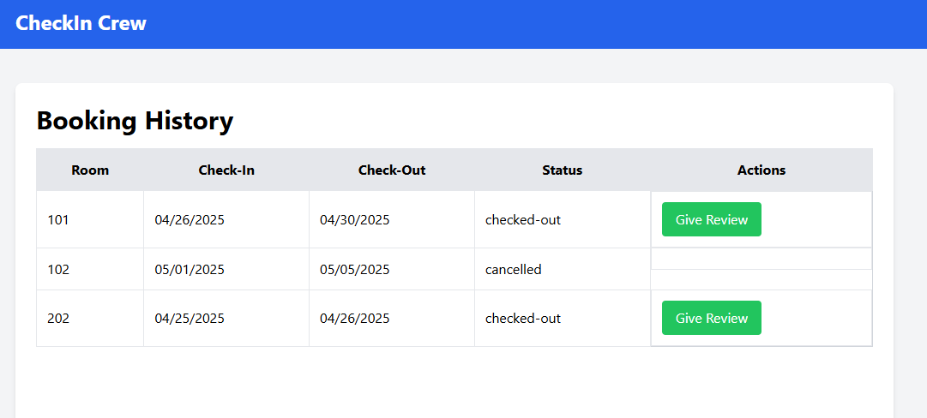
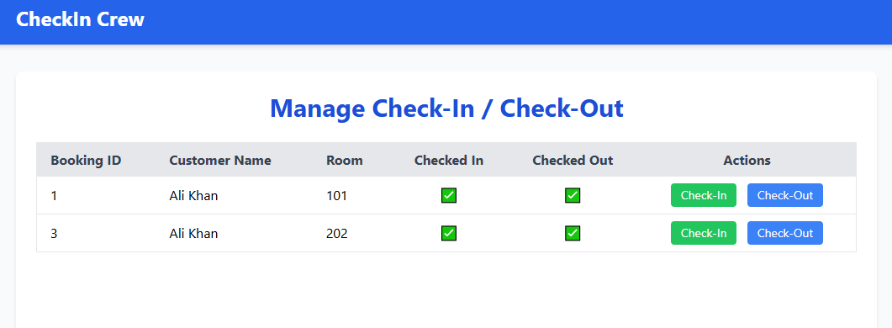

Slide 19
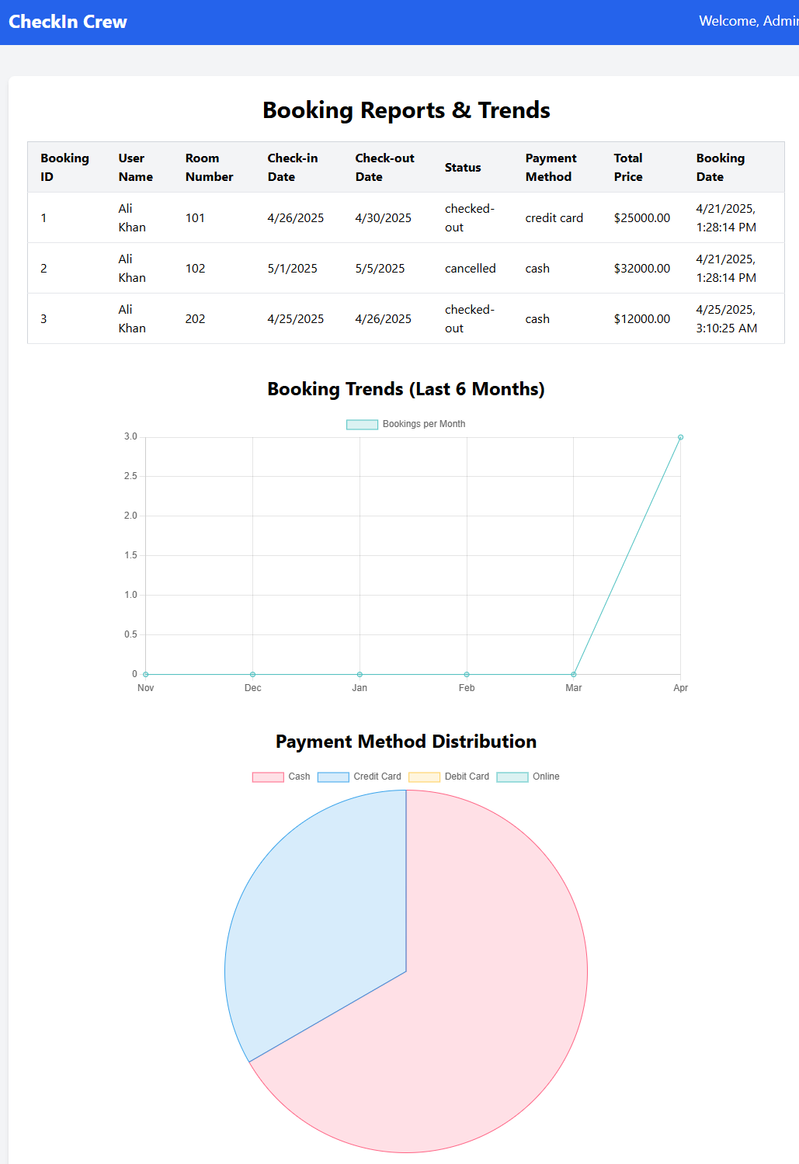
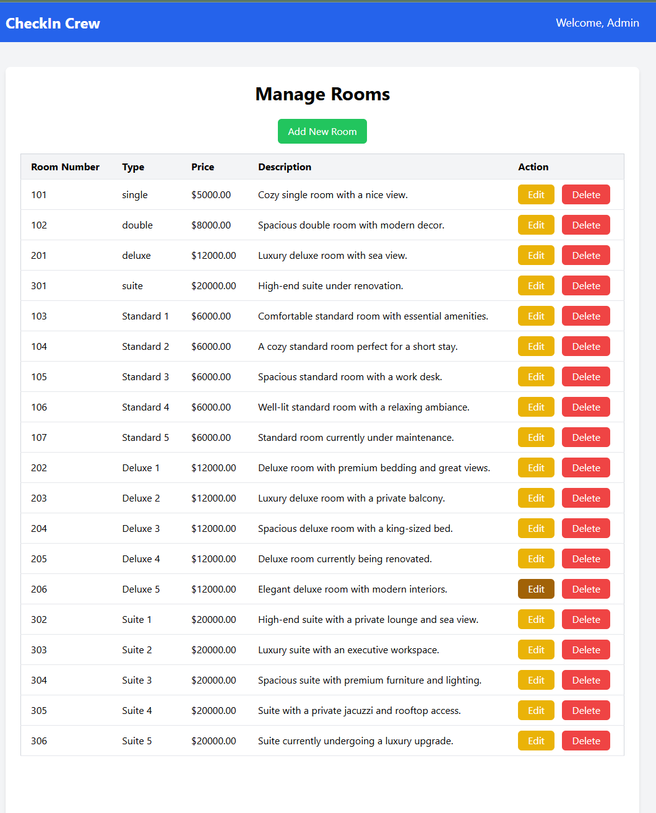

Slide 20
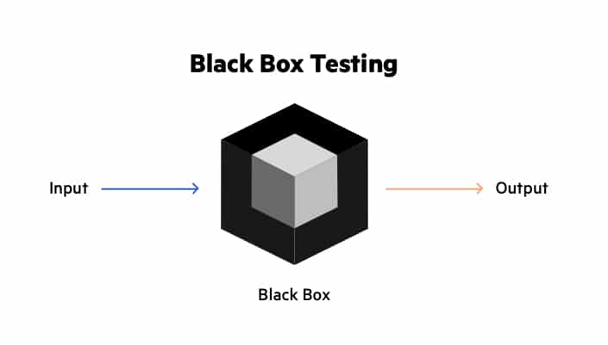
Black Box Testing
Black Box Testing is a software testing method where the tester evaluates the functionality of an application without looking at its internal code structure.
The focus is on inputs and outputs — if the system behaves correctly based on given inputs — without knowing how the processing is done internally.

Slide 21
Equivalence Class Partitioning Table
Input | Valid Classes | Invalid Classes
Room Price | Price > 0 | Price ≤ 0
Number of Guests | 1 to 5 guests | 0 guests, more than 5 guests
Check-In Date | Future date (today or later) | Past date
Check-Out Date | After Check-In Date | Same as or before Check-In Date
Email Address | Valid email (e.g., abc@example.com) | Missing "@" or "." symbols
Password | Length between 6-20 characters | Less than 6 or more than 20 characters
Search Room Input | Location entered | Location field empty
Booking Amount | Booking amount > 0 | Booking amount ≤ 0
Feedback Rating | 1 to 5 stars | Less than 1 or more than 5 stars
Feedback Comment | Text entered | No text entered

Slide 22
Boundary Value Analysis Table
Input | Boundary Values
Number of Guests | 0 (invalid), 1 (valid min), 3 (normal), 5 (valid max), 6 (invalid)
Room Price ($) | 0 (invalid), 1 (valid min), 100 (normal), 999 (high valid), 1000+ (invalid)
Check-In Date | Yesterday (invalid), Today (valid), +1 day (valid)
Password Length | 5 (invalid), 6 (valid min), 10 (normal), 20 (valid max), 21 (invalid)
Feedback Rating | 0 (invalid), 1 (valid min), 3 (normal), 5 (valid max), 6 (invalid)

Slide 23
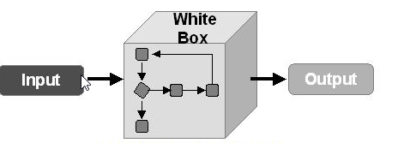
WHITE Box Testing
White Box Testing is a software testing method where the tester examines the internal structure, logic, and code of the application.
The focus is on verifying how the system processes inputs, covering paths, conditions, and loops within the code.

Slide 24
Unit Tests Performed
Testing Framework
Tool Used: Jest
Rationale: Jest is a robust testing framework tailored for Node.js environments. It supports mocking, assertions, and built-in coverage reporting, making it an ideal choice for backend API testing.

Slide 25
Unit Tests Performed
Scope of Testing
Room Management: Creating, retrieving, updating, and deleting room records
Booking Operations: Booking rooms, updating booking details, checking availability, and cancelling bookings
User Services: User login and registration
Staff Management: Staff record operations (CRUD)
Complaint and Feedback Handling: Submission and status tracking

Slide 26
CODE COVERAGE
Coverage Metric | Percentage
Statement Coverage | ~70%
Branch Coverage | ~30-40%
Function Coverage | ~53%
Line Coverage | ~70%

Slide 27
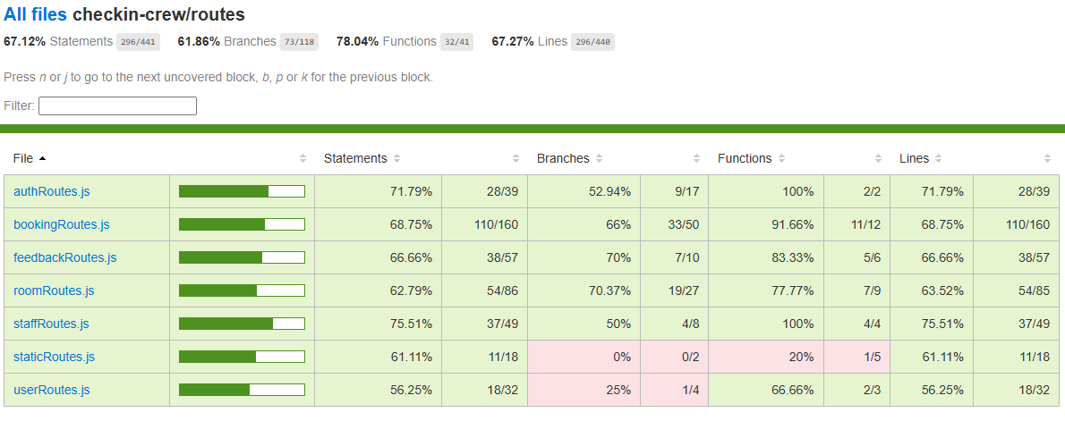
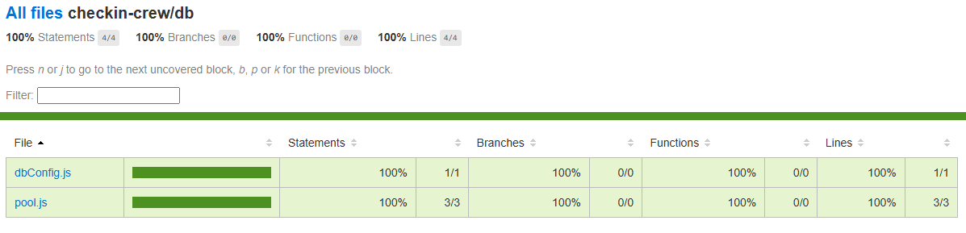
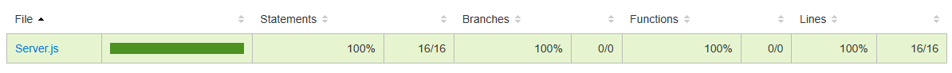

Slide 28
Further Improvements
Real-time notifications for booking changes
Room recommendation system
Cloud hosting for scalability
Chatbot integration for guests

Slide 29
Work division between group members
Haleema Tahir Malik Role: Frontend Developer + Black-box Testing
Muhammad Daniyal Aziz Role: Backend Developer + White-box Testing
Moaz Farooq Role: Database Administrator + Testing
We closely coordinated using GitHub for version control and Trello for task management, ensuring efficient collaboration.

Slide 30
Conclusion
Lessons Learned:
Team Coordination and Communication
Technical Skill Enhancement: Practical experience in full-stack development
Software Engineering Best Practices
Importance of planning and testing
Version Control and Collaboration Tools
Final Thoughts:
Successfully built a functional hotel management prototype!

Slide 31
Thank you!
Team Check-in Crew Signing off!

